Slide 1

Temperature-Aware Computer Systems Opportunities and Challenges
EEL6795 – Power Aware Computing
Presentation

Slide 2
Paper 1 Presentation
Group Members
SULTAN ALAJMI ID-6161681
BADER ALOTAIBI ID-6158056
BANDAR ALOTAIBI ID-6228331
YAHYA BOHAMAD ID-6124824

Slide 3
Abstract
Effects of localized heating and non-uniform power dissipation
Architecture-level thermal modeling
Dynamic voltage scaling
Migrating computation
Temperature-tracking dynamic frequency scaling.
Notes:
This research paper is focused on the power-aware and temperature-specific design technique to understand the effects of localized heating and non-uniform power dissipation across the compartments of computing system. For this purpose, architecture-level thermal modeling is presented in this paper, the need of modeling and techniques are mentioned across which analysis has been built and comparison is done. Some important concepts and computing parameters that are discussed in detail include dynamic voltage scaling, migrating computation, and temperature tracking dynamic frequency scaling.

Slide 4

Introduction
Power-aware design alone has failed to stem the tide of dealing with problems like heat density
Localized heating occurs much faster than chip-wide heating
Power-management techniques must directly target the spatial and temporal behavior of the operating temperature.
Typical high-power applications still operate at 20 percent or more below the absolute worst case
Notes:
Because a microprocessor consumes energy and converts it into heat, the corresponding exponential rise in heat density is creating significant difficulties in maintaining reliability and low manufacturing cost.
Power-aware design alone has failed to stem the tide of dealing with problems like heat density.
Localized heating occurs much faster than chip-wide heating because power dissipation is spatially nonuniform across the chip, this leads to hot spots and spatial gradients that can cause timing errors or even physical damage
For this reason, Power-management techniques must directly target the spatial and temporal behavior of the operating temperature.
One of the reason in this case is packaging. This adds to the effects caused by the overall systems thermal performance. Typical high-power applications still operate at 20 percent or more below the absolute worst case
As long as the threshold temperature that stops the clock (the trigger threshold) is based on the hottest temperature in the system, the approach presented in this paper successfully regulates temperature.

Slide 5
Need for Architecture-Level Thermal Management
Architecture domain of the computing system is unique
Development of workload to control instruction level parallelism
Design manual provides hot spots and temperature gradients for computing system
Role of system-architecture and operating-system is important
This research paper has focused more on microarchitecture to handle thermal problems in computing.
Notes:
The architecture domain is unique in its ability to use runtime knowledge of application behavior and the current thermal status of different units of the chip to adjust execution, distribute the workload to control thermal behavior, and exploit instruction-level parallelism (ILP). The architecture has detailed temperature information about hot spots and temperature gradients that can combine with dynamic information about ILP to precisely regulate temperature while minimizing performance loss.
two new techniques that outperform prior DTM solutions are presented in this paper, but both require design and analysis in the microarchitecture domain, which in turn requires an appropriate modeling capability. Although the presented work has focused on microarchitecture, system-architecture and operating system techniques have an important and complementary role to play. For example, the operating system can use knowledge of different processes’ thermal characteristics to guide scheduling decisions, which again requires an appropriate modeling capability.

Slide 6
Need for Architecture-Level Thermal Modeling
The need for architecture-level thermal modeling is there to avoid temporal and spatial nonuniformities in computing due to thermal effects. An effective architecture-level thermal model must be
Simple enough to allow architects to reason about thermal effects and tradeoffs
Detailed enough to model runtime changes in temperature within different functional units
Yet computationally efficient and portable for use in a variety of architecture simulators.
Notes:
The need for architecture-level thermal modeling is there to avoid temporal and spatial nonuniformities in computing due to thermal effects.
An effective architecture-level thermal model must be
Simple enough to allow architects to reason about thermal effects and tradeoffs
Detailed enough to model runtime changes in temperature within different functional units
Yet computationally efficient and portable for use in a variety of architecture simulators.

Slide 7
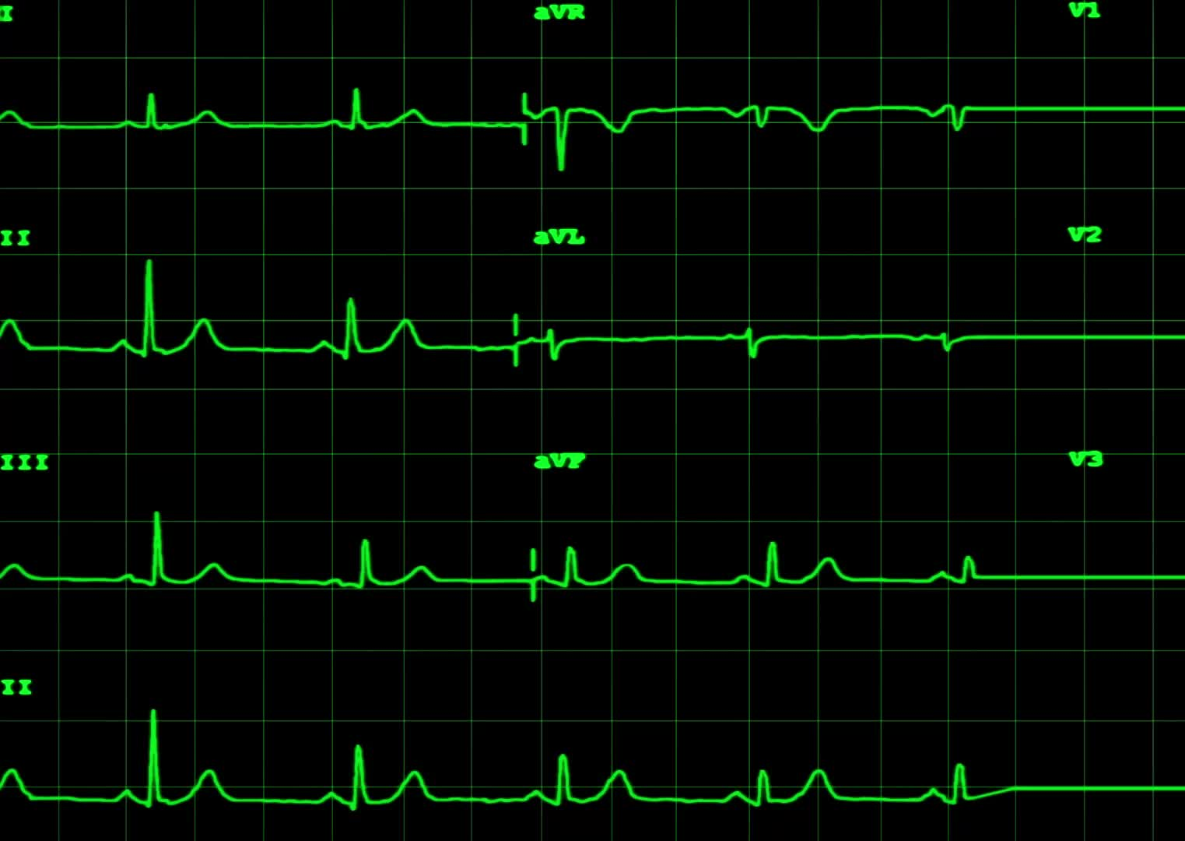
Thermal Modeling at Architecture Level
In the research paper, properties about the compact model of a parametric microarchitecture for a computing system are presented.
It must track temperatures at the granularity of individual microarchitectural units
It must be parameterized in so that a new compact model for different microarchitectures.
It must be able to solve the RC circuit’s differential equations quickly
Finally, it must be boundary and initial-condition independent
Notes:
In the research paper, properties about the compact model of a parametric microarchitecture for a computing system are presented. These points are mentioned below:
It must track temperatures at the granularity of individual microarchitectural units, so the equivalent RC circuit must have at least one node for each unit.
It must be parameterized, in the sense that it can generate a new compact model for different microarchitectures.
It must be able to solve the RC circuit’s differential equations quickly
Finally, it must be boundary and initial-condition independent which means that The thermal model’s component values should not depend on initial temperatures or the particular configuration under study.

Slide 8
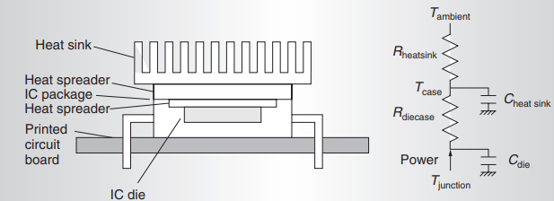
IC package with heat sink: physical structure(Left) Simple compact thermal model(Right)
Notes:
You can compute lumped values of thermal R and C to represent the heat flow among units and from each unit to the thermal package. In the thermal-design community, these equivalent circuits are called compact models, and are called dynamic compact models if they include thermal capacitors. All thermal capacitors are with respect to ground. These are shown in the attached figure.

Slide 9
Temperature-tracking Dynamic Frequency Scaling
Several microarchitecture techniques target runtime temperature regulation. In this paper, a sensor is modeled with the techniques mentioned previously. One sensor per architectural block with random noise of 1⁰C. Temperature versus average power density for gcc with a power averaging interval of 0.033 seconds is presented in the paper.
Notes:
Several microarchitecture techniques target runtime temperature regulation. In this paper, a sensor is modeled with the techniques mentioned previously. One sensor per architectural block with random noise of 1⁰C. Temperature versus average power density for gcc with a power averaging interval of 0.033 seconds is presented in the attached figure.

Slide 10
Temperature-tracking Dynamic Frequency Scaling
Independently of the relationship between frequency and voltage, the temperature dependence of carrier mobility in CMOS means that frequency is also linearly dependent on the operating temperature. This suggests that the standard practice of designing the nominal operating frequency for the maximum-allowed operating temperature is too conservative. When applications exceed the temperature specification, they can simply scale frequency down in response to the rising temperature. Because this temperature dependence is mild within the operating region of interest, the performance penalty for doing so is almost negligible.
Notes:
Independently of the relationship between frequency and voltage, the temperature dependence of carrier mobility in CMOS means that frequency is also linearly dependent on the operating temperature. This suggests that the standard practice of designing the nominal operating frequency for the maximum-allowed operating temperature is too conservative. When applications exceed the temperature specification, they can simply scale frequency down in response to the rising temperature. Because this temperature dependence is mild within the operating region of interest, the performance penalty for doing so is almost negligible.

Slide 11
Dynamic Voltage Scaling
Designers have long regarded DVS as a solution for reducing energy consumption
Researchers have recently proposed it as one solution for thermal management
Transmeta’s Crusoe processors use it for this purpose
When changing the processor voltage, a processor must reduce frequency in conjunction with voltage, because circuits switch more slowly as the operating voltage approaches the threshold voltage.
Notes:
Designers have long regarded DVS as a solution for reducing energy consumption; researchers have recently proposed it as one solution for thermal management and Transmeta’s Crusoe processors use it for this purpose. When changing the processor voltage, a processor must reduce frequency in conjunction with voltage, because circuits switch more slowly as the operating voltage approaches the threshold voltage.

Slide 12
Migrating Computation
From the results, MC is the best DTM technique at 0.8 K/W
It works well for three reasons.
The floorplan used by itself is enough to reduce the operating temperature of the primary integer register file.
MC can exploit ILP to hide the extra latency of the spare register file
The complete elimination of activity in the primary register file allows it to cool quickly, minimizing the use of the slower secondary register file.
Notes:
From the results, MC is the best DTM technique at 0.8 K/W; it works well for three reasons. First, the floorplan we used by itself is enough to reduce the operating temperature of the primary integer register file. This is the dominant effect for a heat sink of 0.8 K/W, where maximum temperatures are not far above 85° C; indeed, the benchmarks we simulated rarely used the spare register file. This shows the importance of considering onchip thermal diffusion in designing the floorplan and in simulating DTM techniques. Second, MC can exploit ILP to hide the extra latency of the spare register file. Third, the complete elimination of activity in the primary register file allows it to cool quickly, minimizing the use of the slower secondary register file.

Slide 13
Conclusion
In terms of modeling, the most important area for future work is the inclusion of heating from the clock grid and other interconnect.
This paper currently approximates the effects of wires by including their power dissipation in the dynamic, per block power density values that drive the RC model.
Different techniques such as Temperature-tracking Dynamic Frequency Scaling, Dynamic Voltage Scaling, and Migrating Computation are presented in detail to overcome the power and thermal issues in computing
Notes:
In terms of modeling, the most important area for future work is the inclusion of heating from the clock grid and other interconnect.
This paper currently approximates the effects of wires by including their power dissipation in the dynamic, perblock power density values that drive the RC model.
Different techniques such as Temperature-tracking Dynamic Frequency Scaling, Dynamic Voltage Scaling, and Migrating Computation are presented in detail to overcome the power and thermal issues in computing

Slide 14
Reference Paper
K. Skadron, M. R. Stan, Wei Huang, S. Velusamy, K. Sankaranarayanan and D. Tarjan, "Temperature-aware computer systems: Opportunities and challenges," in IEEE Micro, vol. 23, no. 6, pp. 52-61, Nov.-Dec. 2018

Slide 15
Thanks

Slide 16
Any Questions

